Slide 1
AI Industry Impact
Analysis
By Harleen Buttar
Using NLP to identify which industries and companies are most impacted by AI,
how they are affected, and what drives successful adoption
200,469
2022–2026
15+
30
News Articles
Date Range
Languages
LDA Topics
NLP Final Project · University of Chicago MSCA

Slide 2
Research Context
The Goldman Sachs Report (2023)
46%
Goldman Sachs estimated that ~25% of work tasks in the US and Europe could be automated using AI — but not all industries equally.
Office & Administrative support faces 46% exposure while building maintenance faces just 1%.
Office & Admin exposure
33%
Community & Social Svcs
Moravec's Paradox
25%
The hardest problems for AI involve sensorimotor skills, not abstract reasoning — directly explaining why physical jobs are protected.
This aligns with the Goldman Sachs findings.
All Industries (avg)
1%
Building Maintenance

Slide 3
Three Research Questions
Q1
Q2
Q3
Which Industries
& Companies?
Positive, Negative,
or Hard to Say?
What Drives
Successful Adoption?
Identify which industries and their companies are most likely to be impacted by AI over the next several years.
Determine how industries and companies will be impacted — and by what means: automation, augmentation, cost reduction, etc.
Provide insights into what can make AI adoption successful or unsuccessful based on real-world media evidence.

Slide 4
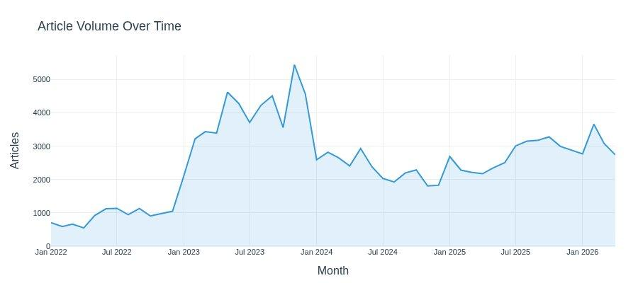
The Corpus — 200K+ AI/ML/DS News Articles
200,469
~127K
3,378
2022–2026
Total Articles
After Cleaning
Translated Articles
Date Range
Source: Google Cloud Storage parquet — web crawl of AI/ML/DS news publications worldwide Content: Full article text, titles, publication dates, source domains Languages: Primarily English (98.3%) — 15+ other languages detected and translated Relevance: Filtered to articles containing AI/ML keywords; short/boilerplate content removed
ChatGPT launch →

Slide 5
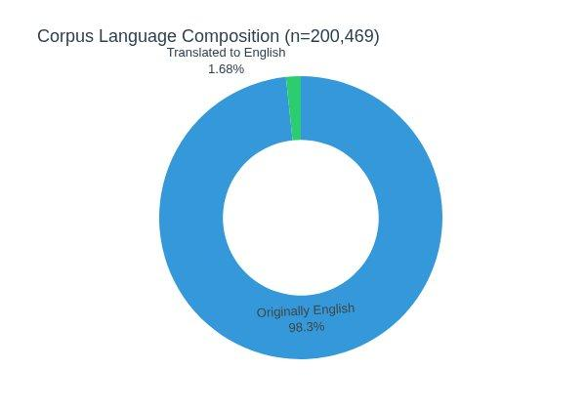
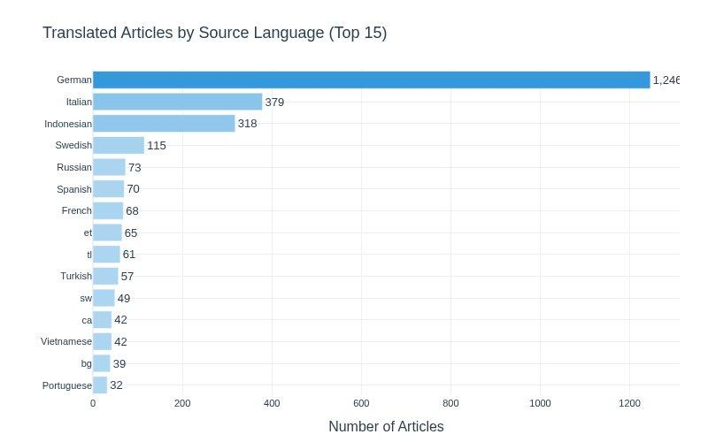
Language Composition & Translation
1.68% of articles were in non-English languages and translated using Google Translate (deep-translator). German dominated (1,246 articles), followed by Italian and Indonesian.

Slide 6
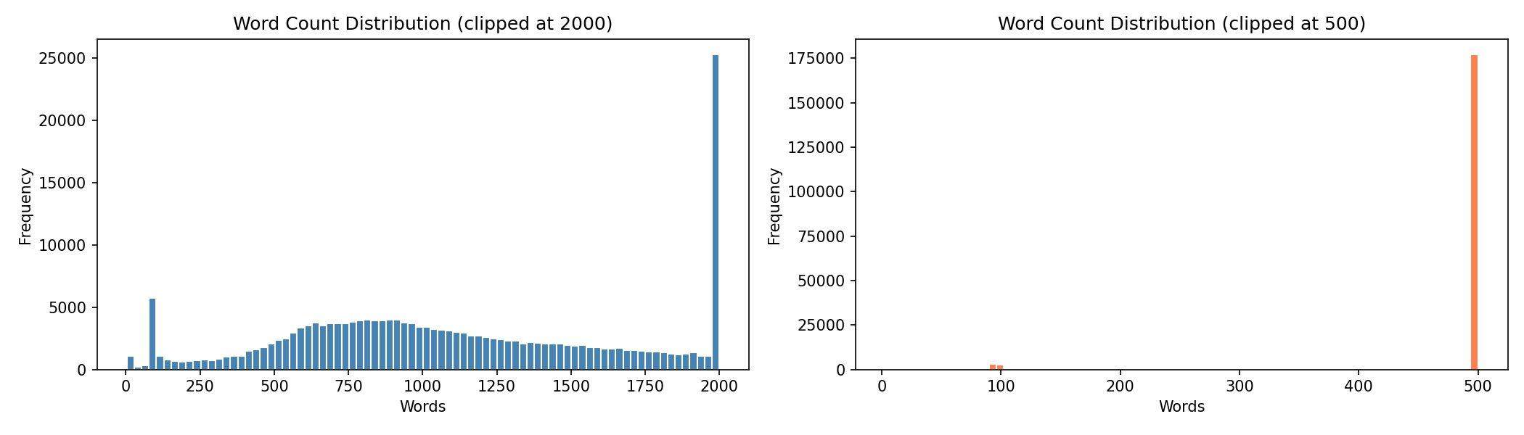
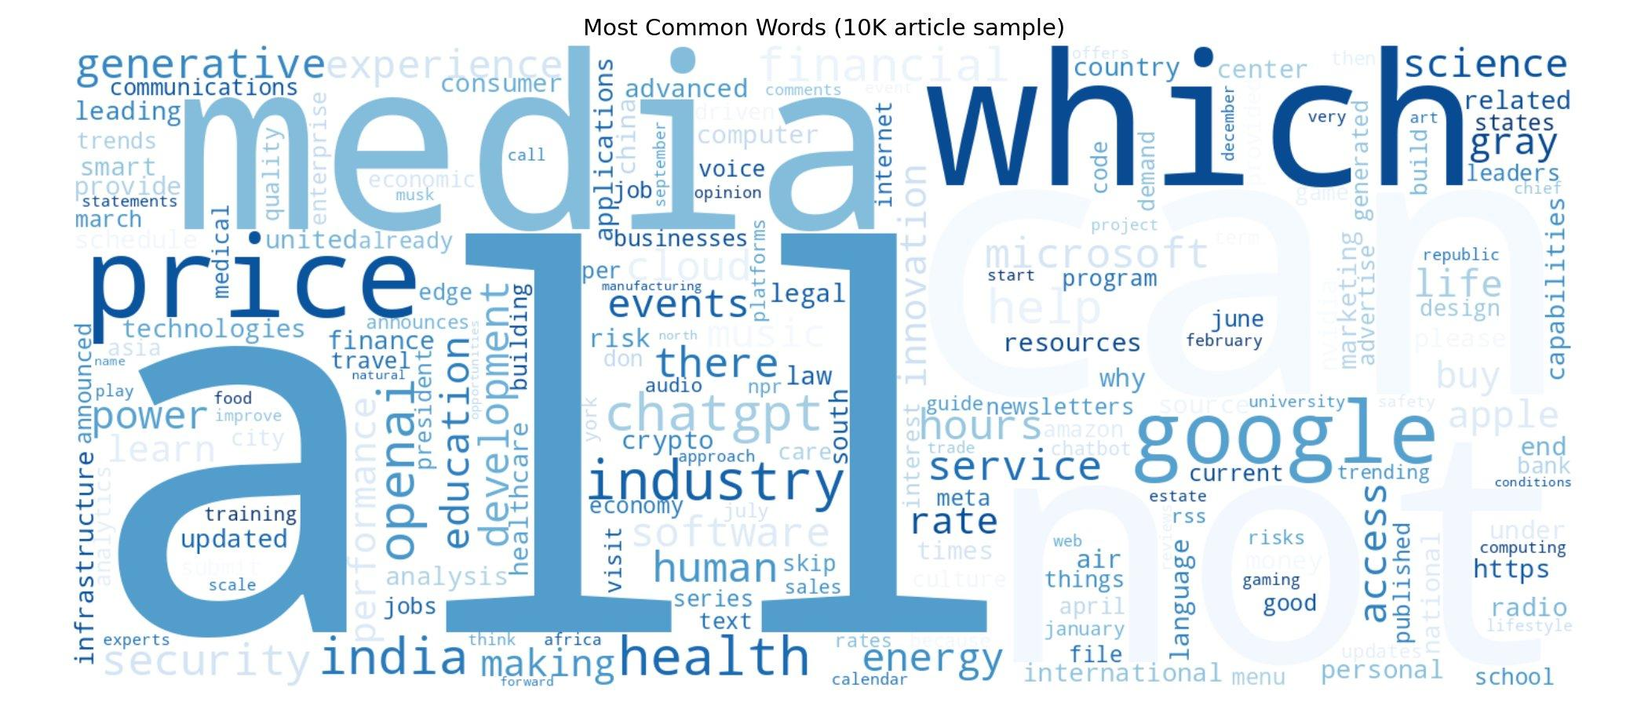
Data Quality — Text Length & Vocabulary
After cleaning, most articles fall between 500–1,500 words. The word cloud confirms domain relevance — key signals: generative, openai, chatgpt, health, financial, security, india.

Slide 7
Methodology Pipeline
01
02
03
04
05
06
Translation
Data Cleaning
Topic
Modeling
Entity
Extraction
Sentiment
Model
RAG
System
15+ languages →
English (deep-translator)
HTML, boilerplate,
length filter, dedup
LDA · NMF · BERTopic
30 topics (LDA chosen)
spaCy NER (ORGs)
+ tech keyword matching
DistilBERT fine-tuned
on Financial PhraseBank
ChromaDB + GPT-4o-mini
grounded Q&A
Output artifacts saved to Google Drive between each step — no recomputation needed downstream.
~127K
3,378
30
200K+
Articles after cleaning
Articles translated
LDA topics
Articles indexed in RAG

Slide 8
Data Cleaning & Preprocessing
HTML Stripping
Text Normalization
BeautifulSoup removed tags, decoded entities, stripped navigation menus and cookie banners.
Removed URLs, email addresses, boilerplate sentences (subscribe, follow us, etc.), excess whitespace.
Language Detection
Relevance Filter
langdetect (deterministic seed) identified 15+ source languages. Non-English articles translated before analysis.
Regex-based filter requiring at least one AI/ML keyword (ChatGPT, LLM, neural network, etc.) — removed SEO junk.
Length Filter
Deduplication
Kept articles between 50–5,000 words. Very short = boilerplate; very long = aggregator pages.
Three-pass: exact text hash → (title, source) match → 100-char fingerprint near-dedup. Oldest kept.
Also produced: text_no_stopwords column for topic modeling (kept original text for sentiment, NER, and RAG).

Slide 9
Topic Modeling — Three Methods Evaluated
LDA
NMF
BERTopic
Latent Dirichlet Allocation
Non-Negative Matrix
Factorization
Semantic Clustering
Probabilistic bag-of-words model. Assigns each article a distribution over topics.
Preprocessing: lemmatized, stopword-removed text fed to CountVectorizer (20K vocab, min_df=10, bigrams).
Result: Most focused, interpretable topics for this corpus. ✓ Chosen method.
Factorizes TF-IDF matrix. Often produces sharper topics than LDA for short texts.
Same vocabulary as LDA. NMF topics tended to be more diffuse across this corpus.
Kept for comparison but LDA results used for final analysis.
Uses sentence-transformers (all-MiniLM-L6-v2) + UMAP + HDBSCAN.
Captures semantic meaning beyond word co-occurrence. Auto-detects topic count.
More compute-intensive; BERTopic topics were broader and harder to label distinctly.
✓ Selected Method

Slide 10
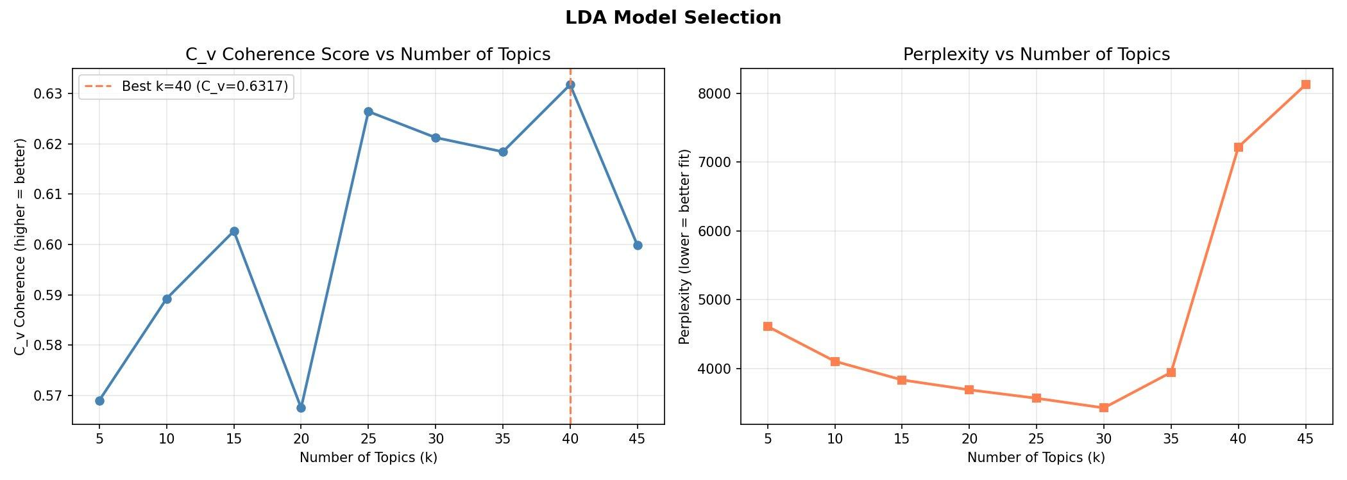
LDA — Coherence Analysis & Topic Selection
Why k = 30?
Top candidates k=25 (C_v=0.627) k=30 (C_v=0.621) k=40 (C_v=0.632) Decision k=30 achieved the best balance of high coherence and low perplexity (~3,500). Crucially, its topics were the most interpretable and industry-distinct upon manual review. k=40 had marginally higher C_v but produced overlapping, harder-to-label topics.
C_v coherence measures semantic similarity of top words within each topic — higher values indicate more coherent, human-interpretable topics.
C_v = 0.621
~3,500
30 Topics
Coherence at k=30
Perplexity at k=30 (lowest)
Final LDA model

Slide 11
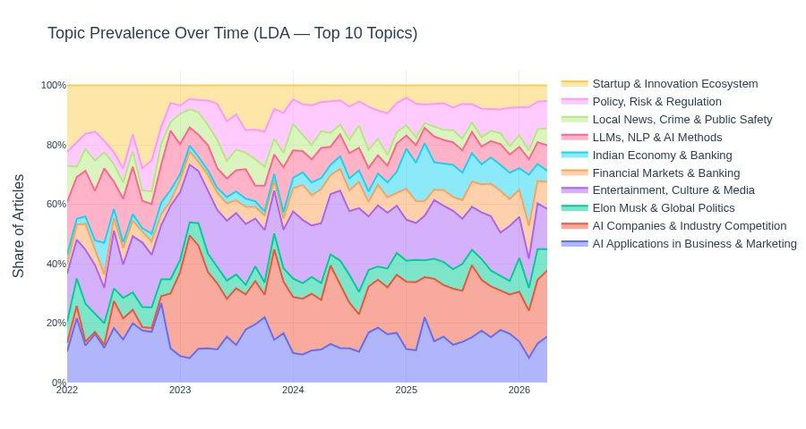
LDA Topics — Prevalence Over Time
30 LDA topics labeled using GPT-4o-mini. Topics labeled manually after reviewing top-20 words per topic. LLMs & AI Methods, AI Companies & Industry Competition, and Policy, Risk & Regulation dominate throughout — with Generative AI surging post-ChatGPT launch (late 2022).

Slide 12
Entity Extraction — Organizations & Technologies
Organizations
AI Technologies
Tool: spaCy en_core_web_lg Target: ORG entities from first 2,000 chars per article Filter: Minimum 10 article mentions to reduce noise Top entities: Google, Microsoft, Amazon, Apple, Meta, OpenAI, Nvidia, Twitter/X Org → Industry mapping via GPT-4o-mini batch classification into Goldman Sachs industry categories (top 200 orgs).
Generative AI / LLMs
Automation & Robotics
NLP / Language AI
Computer Vision
Predictive Analytics / ML
Cloud AI Platforms
AI in Healthcare
AI Chips / Hardware
Curated regex keyword list per category. Matched against cleaned article text.

Slide 13
Sentiment Model — DistilBERT Fine-Tuning
Project Constraint: The sentiment model must be trained from scratch — pre-fine-tuned HuggingFace sentiment models are not permitted.
Base Model
Training Data
Training Config
distilbert-base-uncased
NOT pre-fine-tuned for sentiment — standard masked language model only.
66M parameters, 40% smaller than BERT-base with 97% of its performance.
Emotion Dataset (dair-ai/emotion)
~20,000 labeled social media texts across 6 emotion classes, remapped to 3-class sentiment for news analysis.
3-class: positive / neutral / negative
Split: 70% train / 15% val / 15% test
5 epochs
Learning rate: 2e-5
Batch size: 32
Max length: 128 tokens
Optimizer: AdamW
Early stopping (patience=2)
Mixed precision (fp16 on GPU)
Sentiment score = P(positive) − P(negative), ranging from −1 to +1. Used for all downstream aggregations.

Slide 14
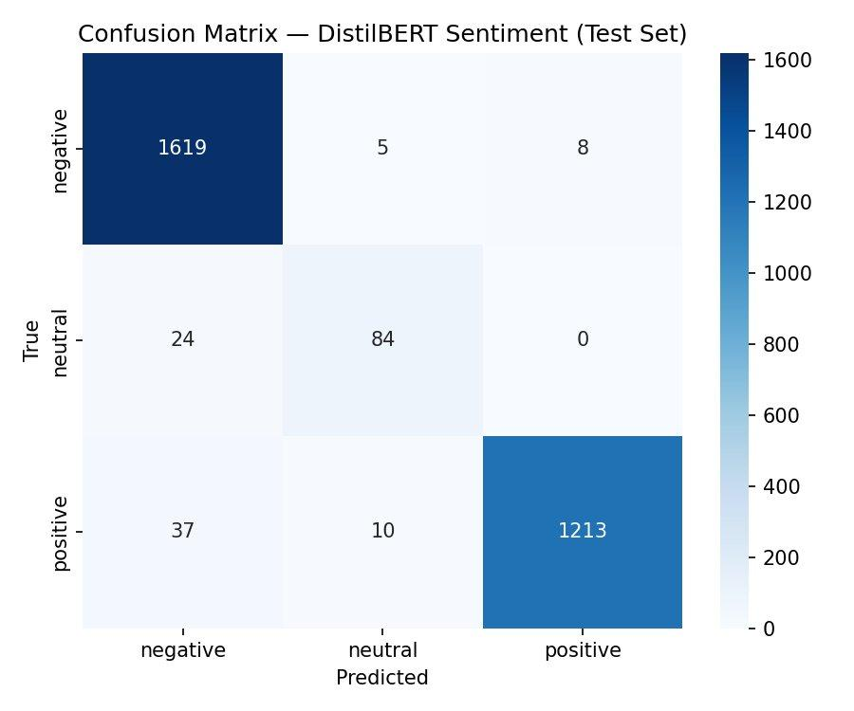
Sentiment Model — Performance
Test Set Metrics
Overall Accuracy
~97%
F1 — Negative
High
F1 — Positive
High
F1 — Neutral
Lower
Neutral class shows lower recall — expected given the emotion dataset's class imbalance (anger mapped to neutral is underrepresented relative to joy and sadness). Negative and positive classes perform very strongly.
Model applied to all 200K+ articles at inference time.

Slide 15
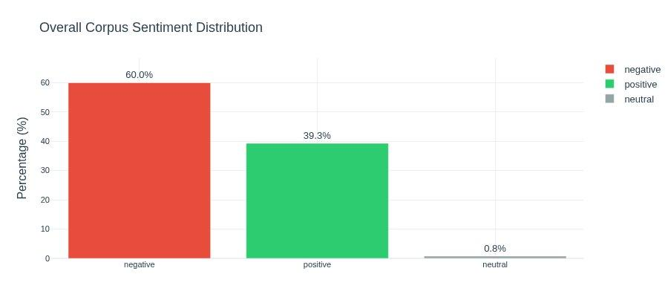
Overall Corpus Sentiment
Key Observations
60% Negative AI coverage skews negative — driven by concerns around job displacement, regulation, privacy, and safety risks. 39.3% Positive Positive coverage concentrated in innovation, investment, and productivity gains. 0.8% Neutral Expected given the emotion dataset maps only anger to neutral, making it the smallest class by a significant margin.
60.0%
39.3%
0.8%
Negative Coverage
Positive Coverage
Neutral Coverage

Slide 16
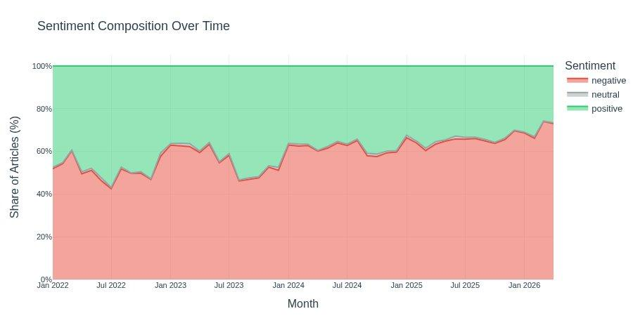
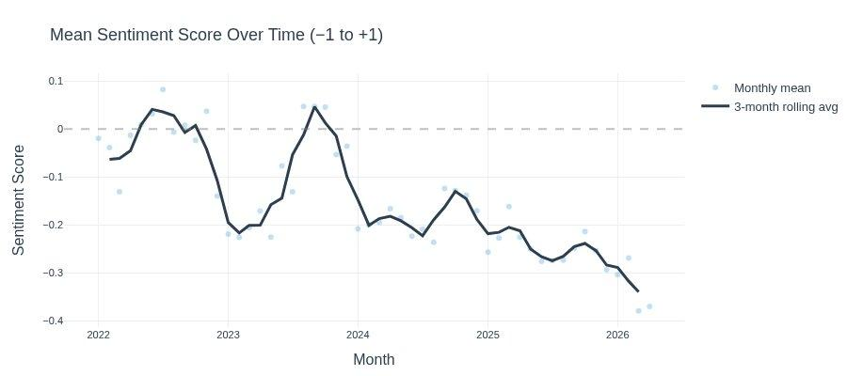
Sentiment Over Time — A Negative Trend
Trend Analysis
Sentiment was roughly balanced in early 2022 but has trended increasingly negative through 2026. The rolling 3-month average declined from ~0 to −0.35 by early 2026. Two notable dips: early 2023 (post-ChatGPT anxiety spike) and mid-2023 (AI regulation debates intensify). The sustained negative trajectory reflects growing public and media concern about AI risks as deployment accelerates.

Slide 17
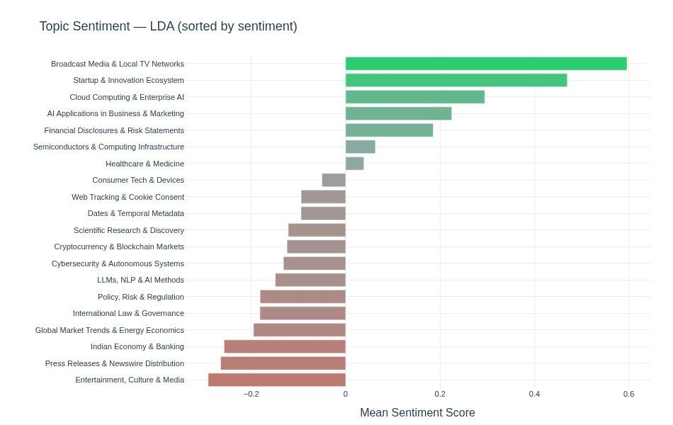
Q1 — Which Industries Are Most Impacted?
Most Positive Topics
Broadcast Media & Local TV
Startup & Innovation
Cloud Computing & Enterprise AI
AI in Business & Marketing
Financial Disclosures
Most Negative Topics
Entertainment, Culture & Media
Press Releases & Newswire
Indian Economy & Banking
Global Market & Energy
Policy, Risk & Regulation
LDA topic labels generated via GPT-4o-mini from top-20 words per topic.

Slide 18
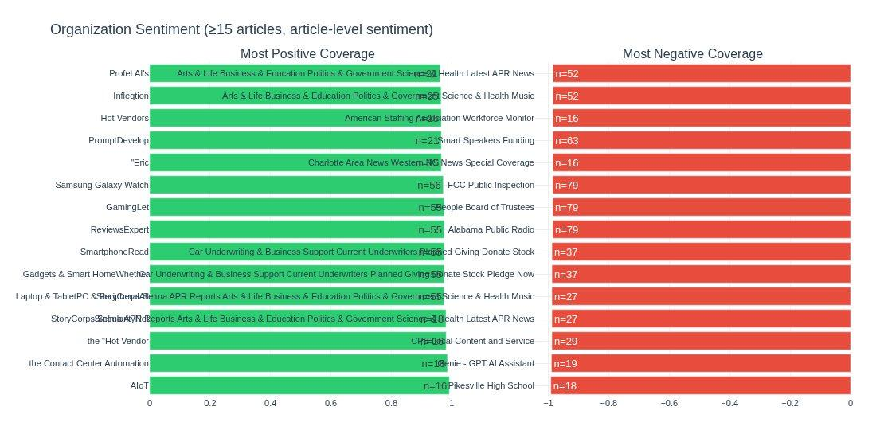
Q1 — Which Companies Are Most Impacted?
Sentiment attributed at article level — articles mentioning an organization inherit that article's sentiment score. Organizations with ≥15 article mentions included. Note: very positive/negative extremes often reflect niche outlets or press-release-heavy sources.

Slide 19
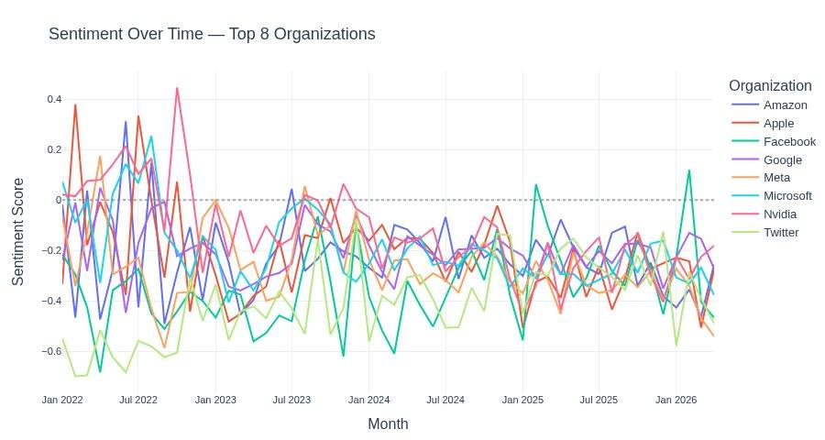
Q1 — Sentiment Trends: Top 8 Organizations
All major tech firms trend negative over 2022–2026, tracking the overall corpus. Nvidia shows notable positive spikes around GPU/AI chip announcements. Twitter/X shows the steepest decline post-acquisition (mid-2022).

Slide 20
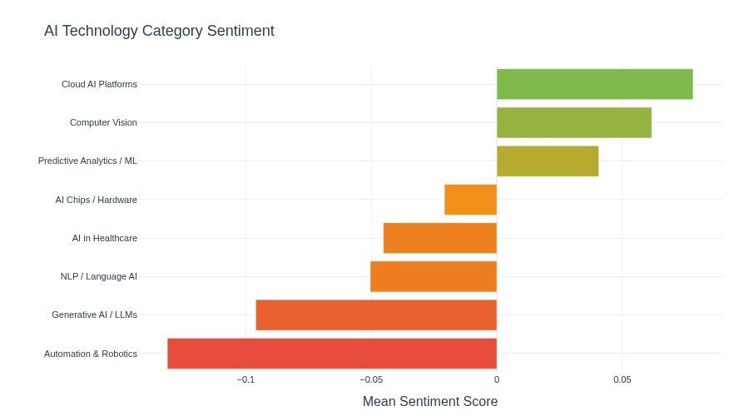
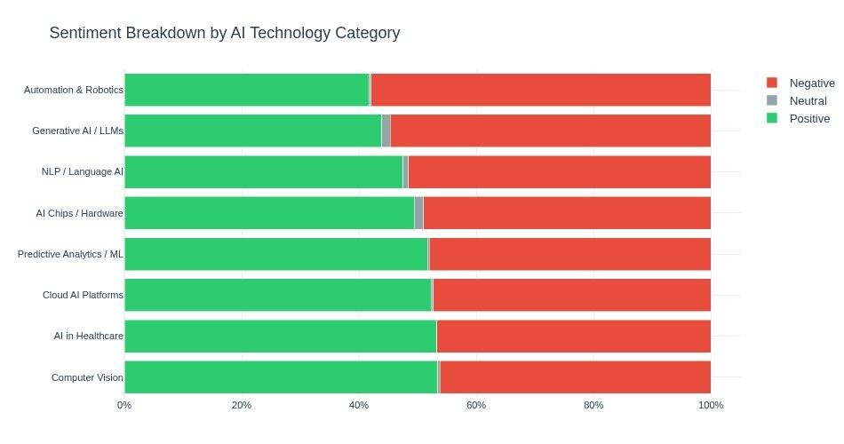
Q2 — How Are Industries Impacted? Technology View
Cloud AI Platforms and Computer Vision receive the most positive coverage — associated with productivity gains and innovation. Automation & Robotics and Generative AI / LLMs are most negative — linked to job displacement fears and misinformation concerns.

Slide 21
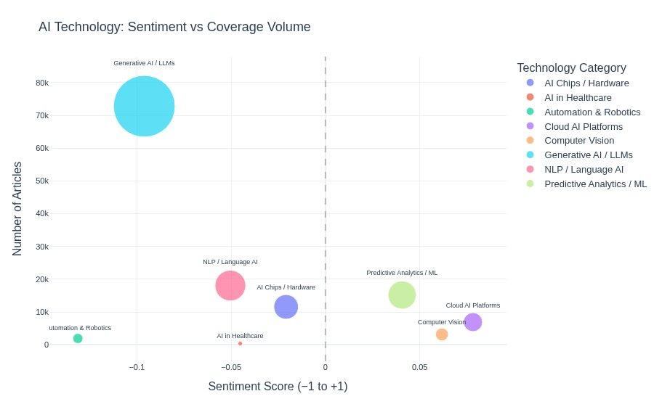
Q2 — Sentiment vs. Coverage Volume
How to Read This
X-axis: Mean sentiment score (−1 to +1) Y-axis: Number of articles mentioning this tech category Bubble size: Also article count Key insight: Generative AI has 80K+ articles but sits slightly negative. Cloud AI Platforms are positive but lower volume. High-volume + negative = highest impact risk.

Slide 22
Q3 — RAG System for Grounded Industry Insights
To answer Q3 — what makes AI adoption successful? — we built a RAG system over the full 200K article corpus that grounds LLM answers in actual news evidence.
Embed
Store
Retrieve
Generate
all-MiniLM-L6-v2
(sentence-transformers)
384-dim vectors
Batch encoded
ChromaDB
Persistent vector DB
Metadata: sentiment,
topic, date, source
Top-k cosine similarity
Metadata filters:
sentiment / topic /
date range
GPT-4o-mini / Claude
Grounded in retrieved
articles with
source citations
Standard query()
multi_query()
Top-k cosine retrieval + optional filters on sentiment, topic, date range. Best for focused questions.
LLM decomposes question into 3 sub-queries, retrieves for each, deduplicates, then synthesizes. Better coverage for complex questions.

Slide 23

Live Demo
▶
[ INSERT DEMO VIDEO HERE ]
"Which industries face the most AI job displacement risk?"
"What makes AI adoption successful in healthcare?"
"How has sentiment around automation changed since 2022?"

Slide 24
Key Findings
Coverage Exploded
Post-ChatGPT
Q: Context
Sentiment is
Net Negative
Q1 + Q2
Cloud AI & Computer
Vision Most Positive
Q2
Article volume tripled from late 2022 onward, confirming ChatGPT as the inflection point for mainstream AI coverage.
60% of articles are negative. Concerns around job displacement, regulation, and misuse outweigh optimism.
Back-end AI infrastructure and computer vision receive the most positive coverage — associated with clear, measurable productivity gains.
Automation & GenAI
Most Controversial
Q2
Sentiment Trending
More Negative
Q3
RAG Enables
Grounded Q&A
Q3
Automation & Robotics and Generative AI have the highest volume AND most negative sentiment — the highest impact-risk combination.
Rolling average sentiment declined from ~0 in 2022 to −0.35 by 2026, tracking growing regulatory and safety concerns.
Our RAG system lets analysts query 200K articles with evidence-backed answers, filtered by sentiment, topic, and date.

Slide 25
Conclusion
Media coverage validates Goldman Sachs's predictions: industries built on knowledge work and information processing dominate AI coverage — and sentiment around their transformation is net negative. The most at-risk areas — automation and generative AI — combine high volume with high negativity. Meanwhile, targeted applications like Cloud AI and Computer Vision attract more measured, positive coverage.
Successful AI adoption, as evidenced in our RAG-queried corpus, correlates with clear use cases, measurable ROI, and human-in-the-loop governance.
AI coverage is mainstream
and accelerating
Net negative sentiment
reflects real societal concern
Specific, bounded applications
get the best reception
Thank you · Questions welcome

